Slide 1

HARARE PROVINCIAL DEVELOPMENT DIALOGUE
Presented By:
F MANDAZA– PUBLIC RELATIONS MANAGER
TOWARDS WORLD-CLASS PARKING EXPERIENCE!!!

Slide 2
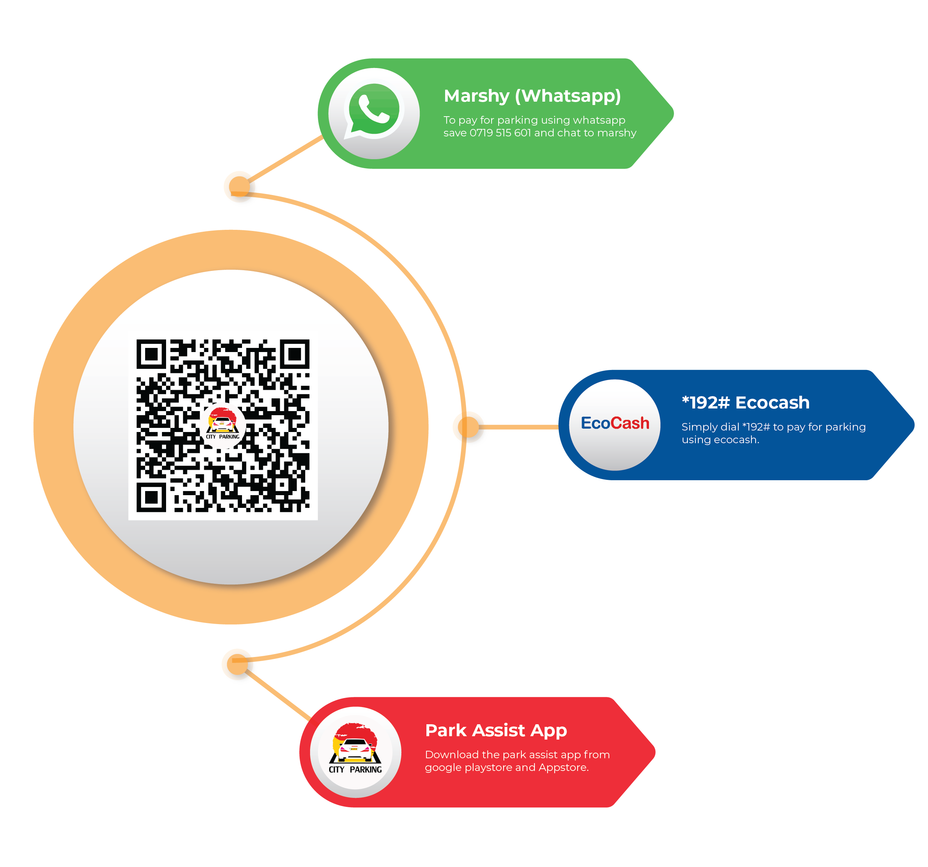
AUTOMATION JOURNEY & INNOVATIONS T
SELF-SERVICE PLATFORMS
USSD, WhatsApp Chatbot and Android mobile apps are available
Payment options includes ZimSwitch, Ecocash and O’Mari

Slide 3
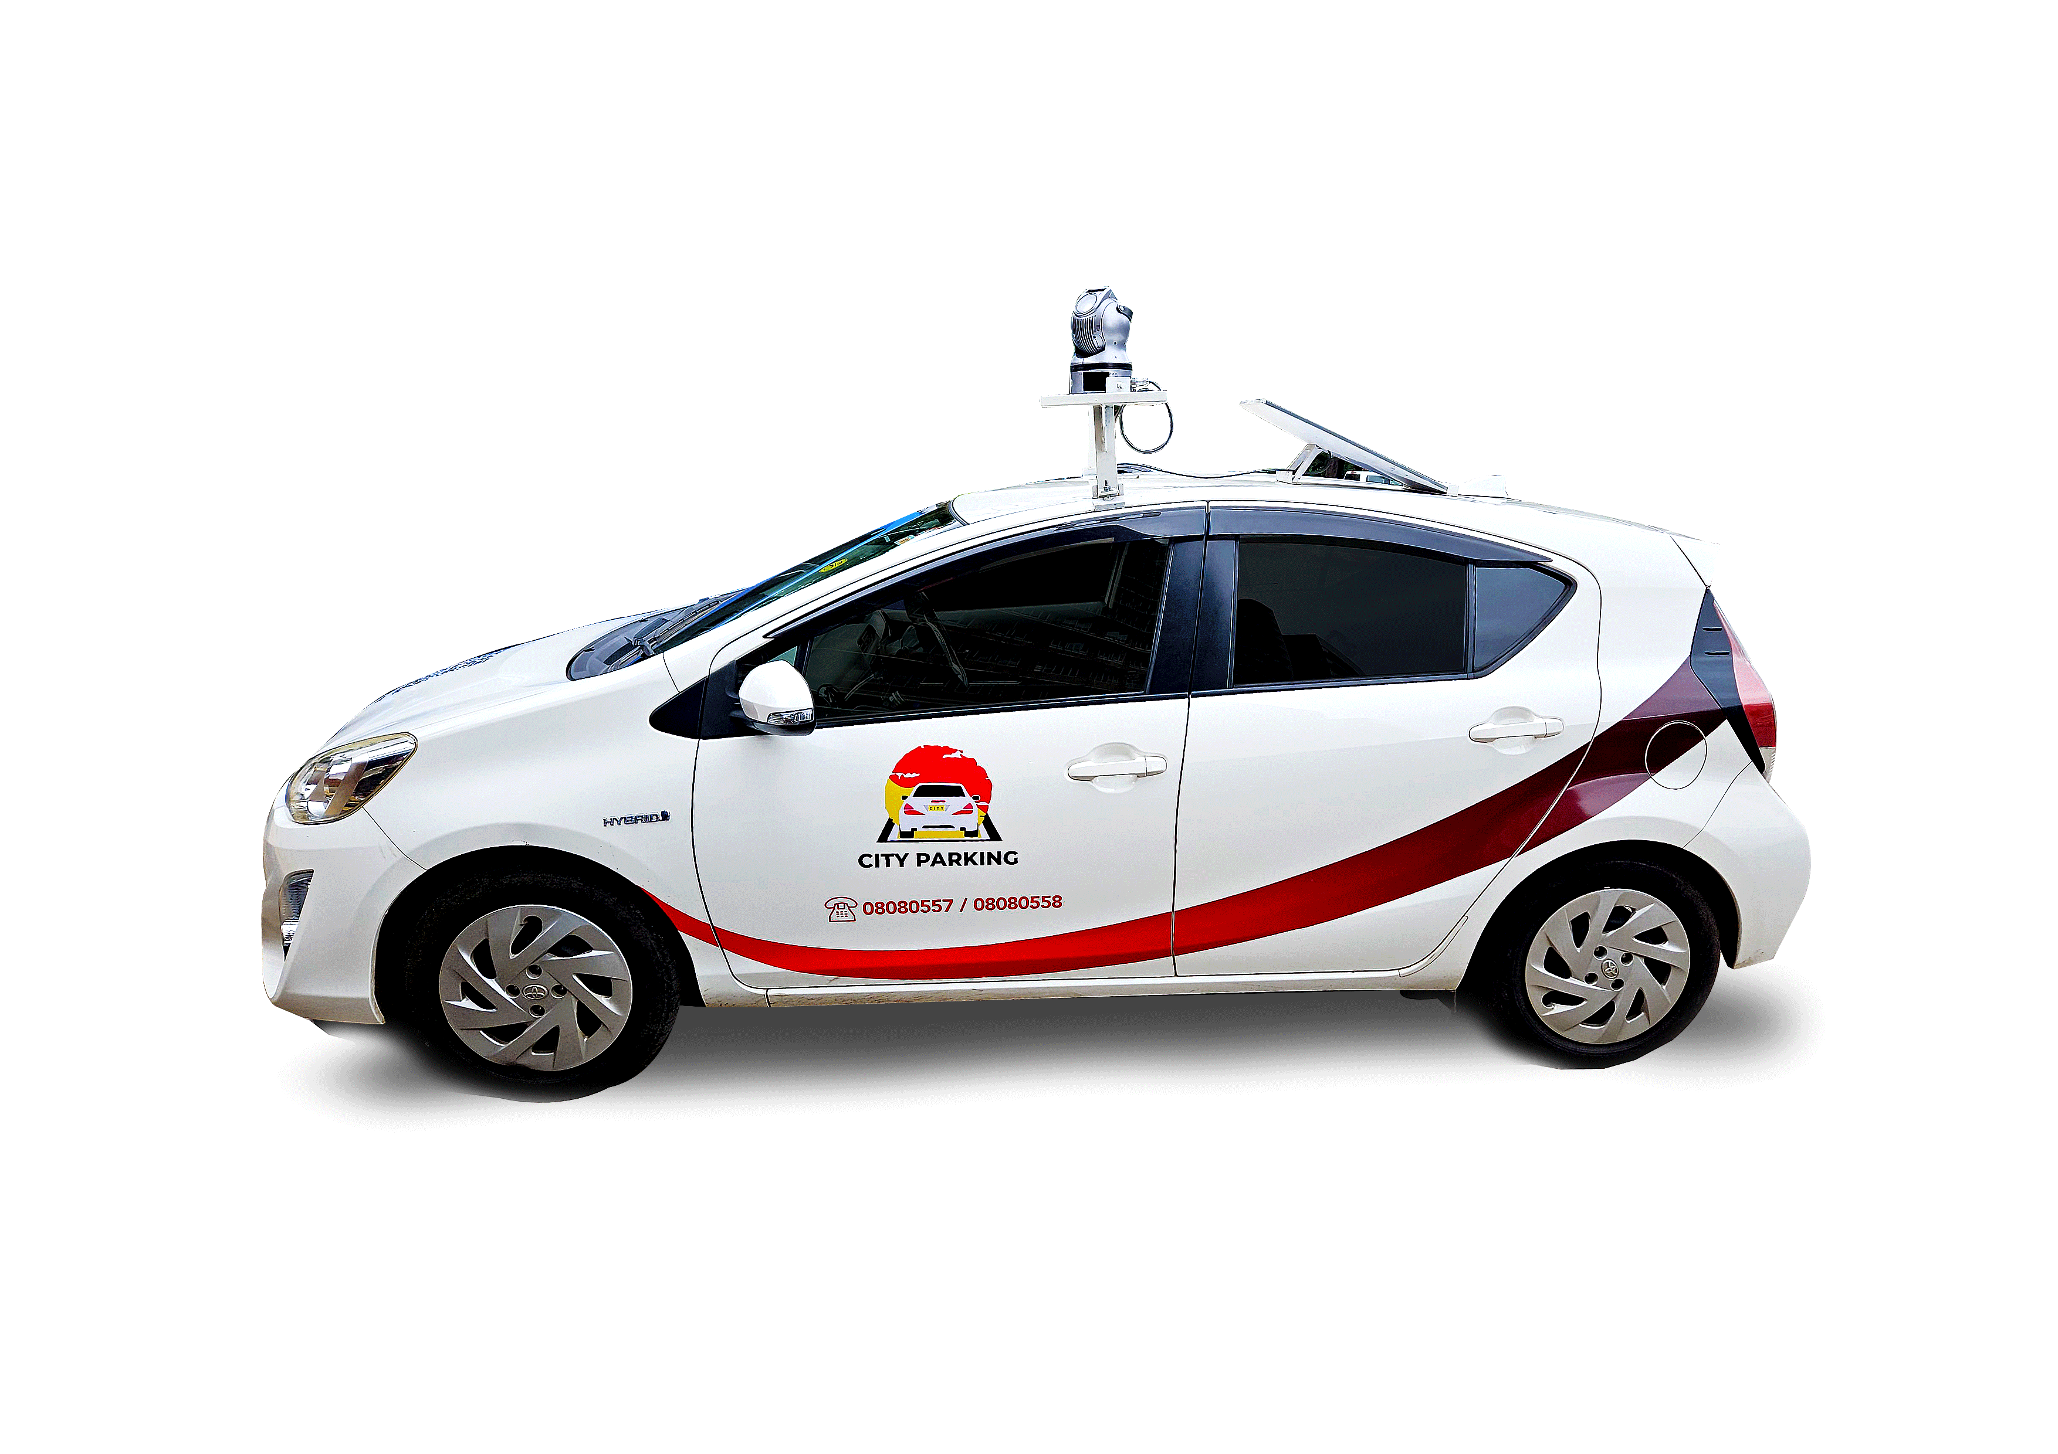
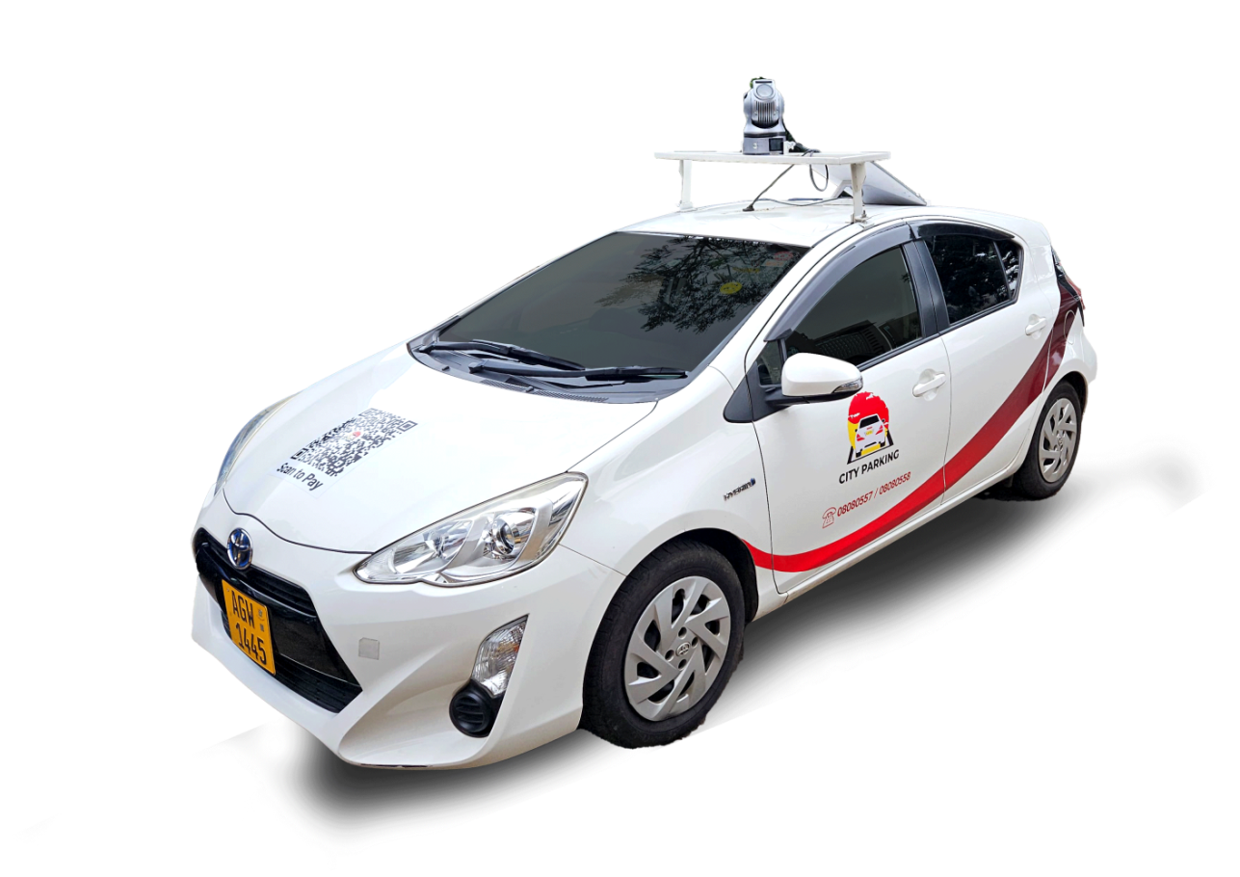
AUTOMATION JOURNEY & INNOVATIONS T
Automatic Number Plate Recognition- (ANPR) system: It automatically detects, read, and record vehicle license plates in real-time using vehicle-mounted mobile cameras for parking management
Live in the streets
Control room dashboard

Slide 4
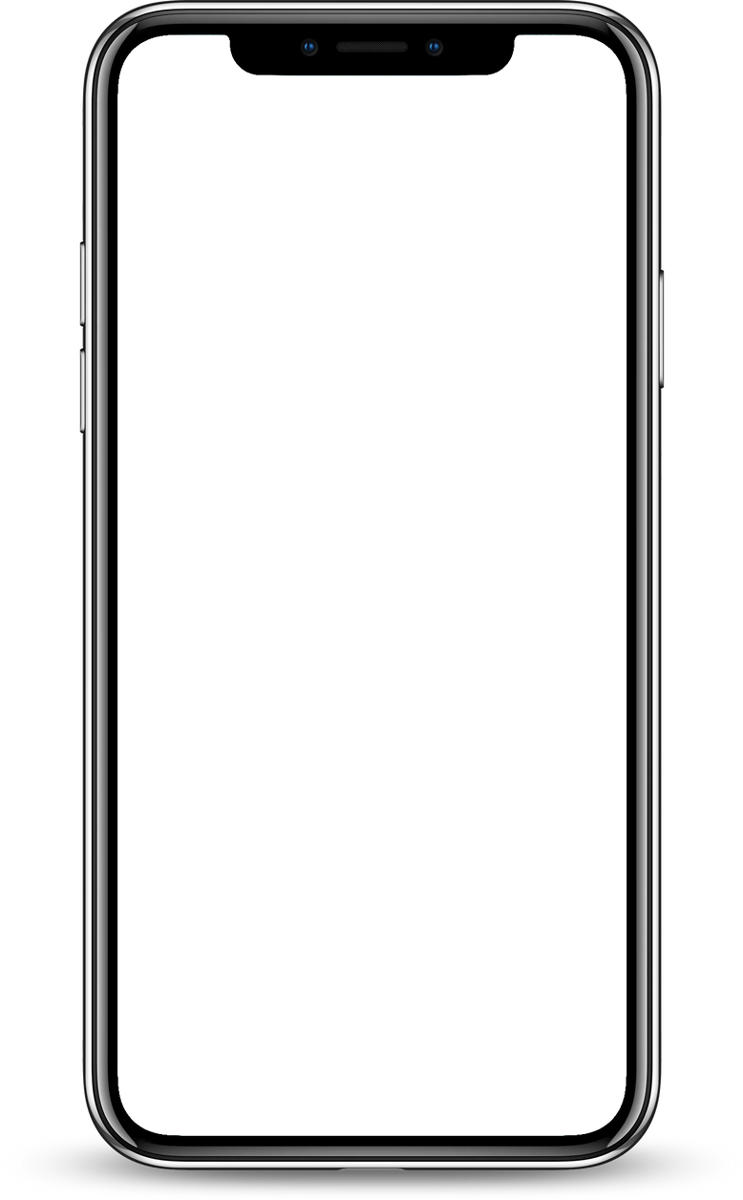
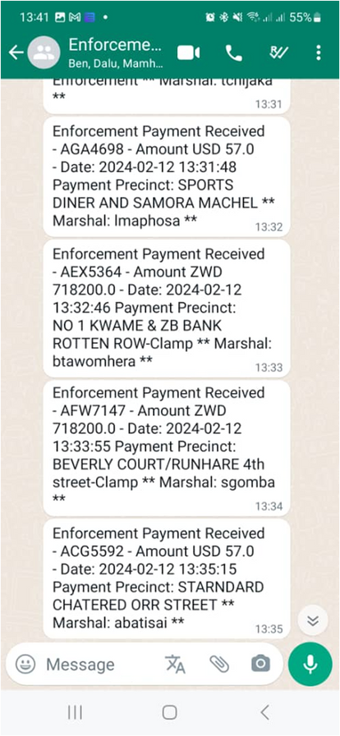
AUTOMATION JOURNEY & INNOVATIONS T
Traffic By-Law Management
City of Harare in 2023 mandated City Parking to enforce codes 90 & 92 of the Traffic By-Law.
Enforcement – Clamping, Tow Away and Storage of vehicles for failure to pay parking fees.
Grace periods-
15 minutes for unpaid ticket
30 minutes for expired ticket
The system gives notifications of vehicles due for clamping

Slide 5
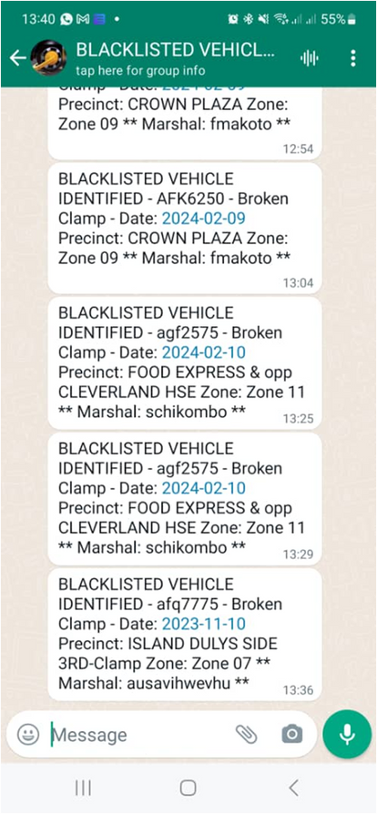

AUTOMATION JOURNEY & INNOVATIONS T
Traffic By-Law Management
Identifies and tracks vehicles that are flagged for reasons such as breaking of clamps and unpaid fines.

Slide 6
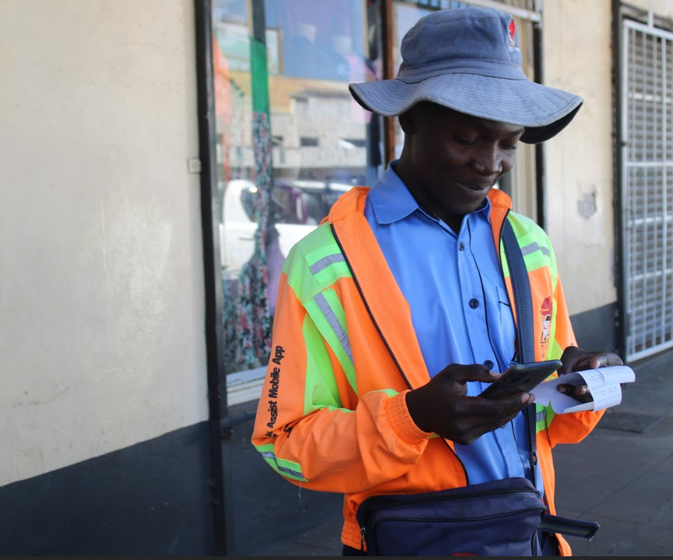
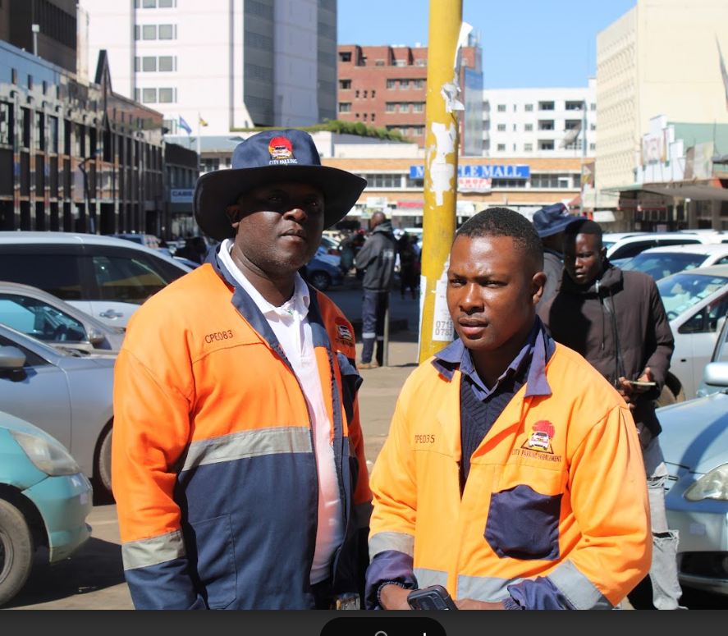
OPERATIVES UNIFORMS

Slide 7
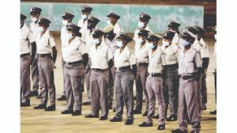
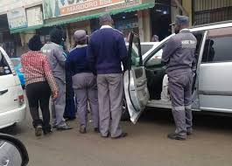
CITY OF HARARE OPERATIVES’ UNIFORMS

Slide 8

THANK YOU !!!
THANK YOU
TOWARDS WORLD-CLASS PARKING EXPERIENCE!!!

